Slide 1
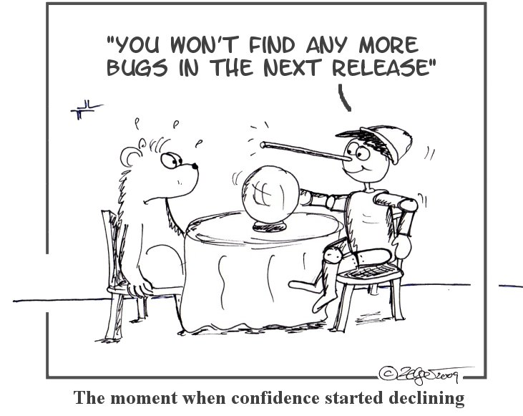
Week 1 - Lecture
SQT – Introduction to SQT

Slide 2
Agenda
Seven Principles of testing
Fundamental test process
Test types
Testing industry
Introduction to testing

Slide 3

Introduction to testing

Slide 4
Software failure examples
Examples:
A new smartphone mapping application (app) was introduced in September 2012. Among many other problems, a museum was incorrectly located in the middle of a river, and Sweden’s second city, Gothenburg, seemed to have disappeared from at least one map.
A small, one-line, change in the billing system of an electrical provider blacked out the whole of a major US city
What is startling about these examples?
Notes:
Examples:
After successful test flights and air worthiness accreditation, problems arose in the manufacture of the Airbus A380 aircraft. Assembly of the large subparts into the completed aircraft revealed enormous cabling and wiring problems. The wiring of large subparts could not be joined together. It has been estimated that the direct or indirect costs of rectification was $6.1 billion. (Note: this problem was quickly fixed and the aircraft entered into service within 18 months of the cabling difficulties being identified.)
When the UK Government introduced online filing of tax returns, a user could sometimes see the amount that a previous user earned. This was regardless of the physical location of the two applicants.
In November 2005, information on the UK’s top 10 wanted criminals was displayed on a website. The publication of this information was described in newspapers and on morning radio and television and, as a result, many people attempted to access the site. The performance of the website proved inadequate under this load and the website had to be taken offline. The publicity created performance peaks beyond the capacity of the website.
A new smartphone mapping application (app) was introduced in September 2012. Among many other problems, a museum was incorrectly located in the middle of a river, and Sweden’s second city, Gothenburg, seemed to have disappeared from at least one map.
A small, one-line, change in the billing system of an electrical provider blacked out the whole of a major US city

Slide 5
Discussion: Why software fails
Can you think of any software failures that have impacted you
What was it? And what failed?
Could testing have prevented it?

Slide 6
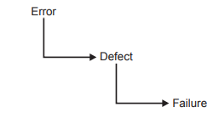
Why software fails
Start from the beginning – how is software made?
Software developers can make mistakes
Pressures of working environments and deadlines
Complexity of systems and organisations
Inadequate analysis
Errors in specifications
An error leads to defects, which in turn lead to failures
Not all errors/failures mean the same to everyone
There is often a ‘grey area’

Slide 7
Effect of software failure
Loss of money
Loss of time
Loss of reputation
Injury
death
Important of the impact of failures.
Incorrect software can harm:
People (incorrect GPS directions, shuttle explosion)
Companies (incorrect billing, loss of revenue)
The environment (releasing chemicals)
Hypothetical example:
A train carrying nuclear waste being involved in a crash
Who will be harmed in this situation?
While it may not be likely, but it is a possibility
Notes:
https://readwrite.com/2020/08/20/software-development-failure/
10 Real Life Software Development Failures
We tend to think large organizations, Fortune 100 companies, and hot brands never mess up in the same ways that our smaller businesses do. But the reality is that they screw the pooch on occasion, too. And when they do, the stakes are often much higher and more visible.
Here’s a look at some real life situations where software development failures caused massive waves and lasting ripples:
Heathrow Airport Disruption
In February of this year, more than 100 flights in and out of London’s Heathrow airport were cancelled, delayed, or otherwise disrupted after technical issues compromised the departure boards and check-in systems. As a result passengers were left without the critical information they needed about their flights. On top of that, there was limited functionality for electronic tickets (which have become quite common in recent years).
While a Heathrow spokesperson issued a statement and said they couldn’t share any more details about what caused the systems to be affected and/or which systems were impacted, they did promise to continue closely monitoring their systems. (But I can promise you, for all of the calm boilerplate statements they released to the public, there was chaos and shouting behind the scenes.)
Deadly Flaw in Medical Infusion Pumps
The company CareFusion designs and manufacturers advanced medical equipment for some of the top hospitals around the world. Unfortunately, they also have their fair share of recalls. And some of them are more dire than others.
In 2015, the CareFusion Alaris Pump, which is designed to automatically deliver fluids and medicine to hospital patients, had a software error that caused the pump to delay infusion. Thankfully the issue was caught very early on, but the consequences could have been dire – potentially leading to accidental overdosing.
But that’s not all. CareFusion’s week got a lot worse when just four days later they had to issue a Class I recall for a separate line of ventilators. The issue? A software flaw that could cause patients to suffocate.
F-35 Fighter Plane Glitch
A couple of years ago, a software glitch in an F-35 Joint Strike Fighter jet was identified to have a bug. The bug actually caused planes to incorrectly detect and lock in on the wrong targets when flying in formation.
As the company explained, each of the planes flying in formation must detect a target from varying angles. But the software was unable to differentiate between one target and multiple targets. In essence, the F-35s were seeing double. (And that’s not something you want when flying in formation at high speeds and high altitudes.)
Uber Software Bug Catches “Cheater”
Okay, let’s take a temporary break from the serious ones. Here’s one that’s pretty funny (unless you’re the main character of the story, that is.)
In France, a bug within the Uber app actually revealed a man’s affair with another woman to his wife. It ultimately led to a divorce and got Uber slapped with a $45 million lawsuit.
The bug, which causes Uber notifications to be pushed to a device even after you log out of the account on a specific device, actually sent several notifications to the Frenchman’s wife – clearly outlining his rendezvous to his mistress’ flat. The wife allegedly received the notifications because her husband had once called an Uber from her phone.
Software Bug Aids in Bank Heist
In 2016, a group of advanced hackers/thieves hijacked the Bangladesh Bank System and successfully transferred out over $81 million in four different transactions. They had another $870 million lined up, but a spelling error tipped off the bank and caused these additional transfers to be canceled.
But here’s where it gets interesting.
According to a release by the Bangladesh Bank authorities, there’s a printer set up to automatically print read-outs of all transactions made. But there just so happened to be a glitch in the system (which could have been caused by the thieves, I supposed) that interrupted this printing process. So it wasn’t until several delays later that the transfer receipts were tracked down. This gave the thieves ample time to “get away” and cover their tracks.
TSB Bank Outage Locks Clients Out
When you store your money in a bank, you expect to be able to access it whenever and wherever you want. But, alas, technology doesn’t always afford this freedom. And while you’ve probably experienced a minor glitch in online banking in the past, I bet you’ve never had to go through one like this.
In April 2018, millions of TSB Bank customers were locked out of their accounts after a “simple” upgrade to the software led to a massive banking outage. The system upgrade was planned, but apparently not well enough.
Immediately after TSB turned on the new system, customers began experiencing issues logging in. Others were shown details of other people’s accounts. There were also reports of inaccurate credits and debts. Many customers were locked out of their accounts for two weeks before regaining access.
Hospital Computer Failure
Also in 2018, Wales National Health Service (NHS) experienced a widespread computer failure that led to issues accessing patient files. In many hospitals and facilities, doctors were unable to see patient files. This meant they couldn’t access X-ray results or bloodwork. It also led to a backlog in appointments, since patients couldn’t be seen and the system didn’t allow for cancellations.
A $400 Million Software Glitch
To assist in the sale of the company to Tesla, SolarCity Corp retained an investment bank. But it wasn’t until after the $2.6 billion agreement was signed that the bank, Lazard Ltd., discovered they had actually undervalued their client by roughly $400 million. While the error was too late for the SolarCity shareholders, Tesla did make an offer to provide some stock to make up for the difference in valuation.
Missile Strike False Alarm
You might remember this one, because it was pretty big news at the time. Back in 2018, citizens of Hawaii were given a state-wide alarm to take immediate cover in the face of an inbound ballistic missile strike. As you can imagine, people panicked and did whatever they could to “protect” themselves. Unfortunately (or fortunately, I supposed) it turned out to be a false alarm.
The biggest issue with the entire debacle was that it took more than half an hour for the alert to be retracted. And while investigations would later show the problem to be the result of human error, they did find some very troubling flaws in the Hawaii Emergency Management Agency’s alert origination software.
Toyota Car Accidents
A few years back, Toyota drivers began reporting a troubling issue: Their cars were accelerating without them actually touching the gas pedal. And after a few accidents, which were carefully investigated, it was discovered that software errors in the system were causing these dangerous issues.
According to reports, the software installed on these Toyota cars had a variety of issues like memory corruption, disabling safety systems, incorrect memory handling, and systems with single points of failure. Toyota eventually recalled millions of vehicles and the company’s stock price would eventually drop by 20 percent in a matter of weeks.

Slide 8

Question
Is it possible to test for every possible scenario?
Consider the mapping app example
if every test had been run, the testing would still be running now, and the product launch would never have taken place

Slide 9
Software testing and risk
Exhaustive testing is not possible
But risk is inherent in any software product
The aim is to minimise risk and improve quality
Uncertainties become significant as complexity increases
Amount of testing depends on the software
Which system, requires more testing?
Automatic flight control system
Video game system
there are known knowns; there are things we know we know. We also know there are known unknowns; that is to say we know there are some things we do not know. But there are also unknown unknowns—the ones we don't know we don't know.
-Donald Runsfeld, 2012

Slide 10
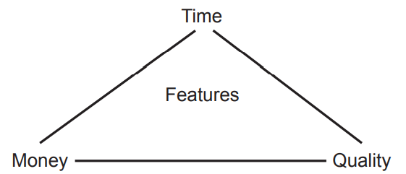
Software Testing and quality
Quality is very difficult to define – differs from person to person
“meets user requirements” – Toyota car accidents
Parts do not always correctly make up a ‘whole’ – Airbus A380
Software development must balance competing demands, just like any project
Influences
Features
Bugs being fixed
Development cycles
Software testing ensure some level of quality of the software being developed.
Question:
How much testing is enough?
Notes:
Airbus:
After successful test flights and air worthiness accreditation, problems arose in the manufacture of the Airbus A380 aircraft. Assembly of the large subparts into the completed aircraft revealed enormous cabling and wiring problems. The wiring of large subparts could not be joined together. It has been estimated that the direct or indirect costs of rectification was $6.1 billion. (Note: this problem was quickly fixed and the aircraft entered into service within 18 months of the cabling difficulties being identified.
Toyota Car Accidents
A few years back, Toyota drivers began reporting a troubling issue: Their cars were accelerating without them actually touching the gas pedal. And after a few accidents, which were carefully investigated, it was discovered that software errors in the system were causing these dangerous issues.
According to reports, the software installed on these Toyota cars had a variety of issues like memory corruption, disabling safety systems, incorrect memory handling, and systems with single points of failure. Toyota eventually recalled millions of vehicles and the company’s stock price would eventually drop by 20 percent in a matter of weeks.

Slide 11
What is software testing
An activity used to reduce risk
A method to check if the software product matches expected requirements
Evaluates and verifies that a product does what it is supposed to do
A testing process evaluates software by testing its attributes
Reliability
Scalability
Portability
Reusability
Usability
Notes:
https://www.javatpoint.com/software-testing-tutorial

Slide 12
What is software testing
More specifically
It is a group of techniques to determine the correctness of the application according to specifications
But….
Testing cannot find all defects
There will always be an “unknown unknown”
Tests can include
Examination of code
Conditions
Behaviours
Interactions with external data sources
Many more

Slide 13
Why is testing necessary
The success of software depends upon acceptance of its targeted audience, easy graphical user interface, strong functionality load test
Banking V Gaming audiences
Testing identifies:
Defects
Reduces flaws
Increases quality
Inadequacies in development process
(Tries to)Ensures that the product delivered is what the customer wanted
Notes:
https://www.indiumsoftware.com/blog/why-software-testing/#:~:text=The%20goal%20of%20software%20testing,comparison%20to%20the%20actual%20requirements.&text=Software%20testing%20is%20important%20because,the%20software%20product%20is%20delivered.

Slide 14
Common testing activities
Test planning
Use cases
Test case design
Sizing and dimensioning
Test implementation
Debugging
Test Reporting
Documentation
Output and analysis

Slide 15

Seven Principles of testing

Slide 16
Discussion: Consider a scenario
Moving a file from folder A to Folder B – Think of all possible ways you can test this
Trying to move the file when it is Open
You do not have the security rights to paste the file in Folder B
Folder B is on a shared drive and storage capacity is full.
Folder B already has a file with the same name
………….Etc.
Seven principles aid in optimizing and directing your testing efforts.

Slide 17
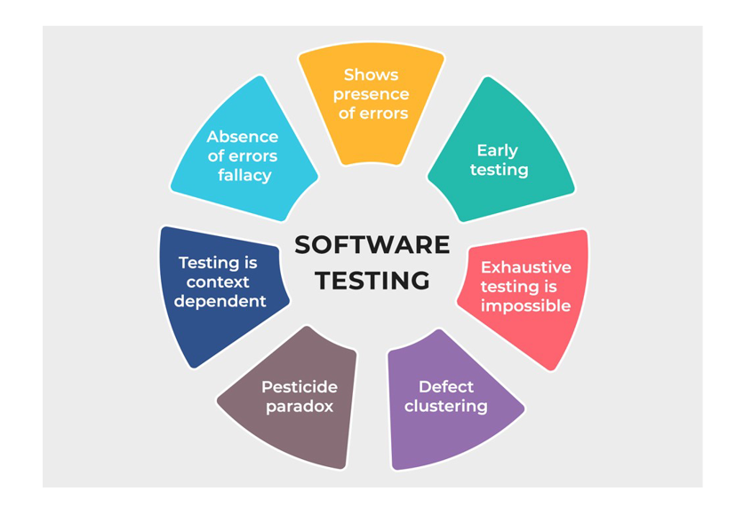
Seven Principles of software testing
Testing shows the presence of defects
Exhaustive testing is not possible
Early testing
Defect clustering
Pesticide paradox
Testing is context-dependent
Absence of errors fallacy

Slide 18
1 - Testing shows the presence of defects
The objective of testing is to find errors and defects in your application
E.g. to make the software fail
Question:
If no defect is found, is your application defect free?
Testing can reduce the number of defects/errors, but cannot ensure software is 100% free of defects.

Slide 19
2 - Exhaustive testing is not possible
Software testing is not about testing all possible scenarios.
This is impossible
If this was attempted, testing would never finish
It is very difficult to test all functionalities with all valid and invalid input combinations
Testing is performed (usually) based on
requirement documents
test cases
Specifications
use cases etc
Testing can be heavily impact by:
incorrect specifications
incorrect assumptions
misunderstood user cases etc

Slide 20
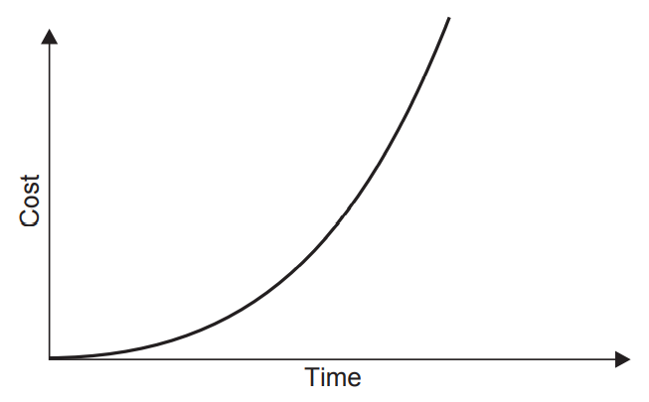
3 – Early Testing
Sometimes may see “shift-left” testing
Test stuff earlier
But, careful not to ‘shift’ to far left
Does not mean don’t test later.
Testing should start as erly as possible in SDLC
The earlier a defect is found, the more time there will be to do something about it.
But how early
As soon as requirements are defined
Usually at “requirement analysis” phase
Notes:
What exactly do we mean by the term "Shift Left"?
The principle of Shift Left is to take a task that's traditionally done at a later stage of the process and perform that task at earlier stages. An example of this is testing. With the traditional Waterfall model, testing is done just before releasing the product into production. This means that serious problems uncovered so late can cause major redesign and long delays. Shift Left Testing addresses this by involving testing teams early in the process. Issues, be it in design or code, can be solved early on before they become major. In fact, shift-left is less about problem detection and more about problem prevention.
Shift Left doesn't mean "shifting" the position of a task within a process flow. It also doesn't imply that no testing is done just before a release. It should be seen as "spreading" the task and its concerns to all stages of the process flow. It's about continuous involvement and feedback. In addition to the process changes, Shift Left is also about the people. For example, testing teams must now work more closely with development teams.
What are the key benefits of Shift Left?
Shift Left identifies potential roadblocks and bottlenecks early on when there's still scope to change and improve design. Problems are addressed long before release without giving into pressure of an imminent deadline. There's obvious cost savings for the project since problems identified earlier are cheaper to fix. Shift Left reduces risk since many issues are addressed long before the release. Releases can be made faster with better quality.
Automation is essential. This reduces human errors, increases test coverage and lets testers focus on more inspiring tasks.
Since teams work closely, some level of whitebox testing can be done. It's also easier to estimate effort and plan for resources. Often debugging problems in production is hard and shift-left ensures most problems are caught much earlier, where they are easier to debug and fix.

Slide 21
Comparative cost to correct errors
Stage error is found | Comparative cost
Requirements | $1
Coding | $10
Program testing | $100
System testing | $1000
User acceptance Testing | $10,000
Live running (production) | $100,000

Slide 22
4 – Defect Clustering
Often, the majority of defects come from a small number of modules/classes/functions etc
Complex modules
Many data sources
A lot of integration points
Legacy code
Impact – where one defect is found, likely more will be found
Pareto Principle
What to do about it?
Identify risky modules
Incorporate it into test planning
Reduce amount of changes
The more changes, the higher risk of defects.
Analyse and prioritise
Remember, we cannot test everything!
Notes:
01) Testing shows the presence of defects
“We can never say that our system is defect free”
Major thing is, as a tester we test software to determine defects. So, we can be confident that the system is working properly. Anyhow, during the testing, the software does not fully verify that there are no defects at all. Testing can significantly reduce the number of undetected defects hidden in the software but it cannot prove that software is 100% defect free. Moreover, if no defects are found, there is no evidence of accuracy.
Example: Let’s assume a mobile phone with any brand, some features may not work with our expectation when we use it for a while.
Can we imagine that kind of branded mobile company has marketed their product without testing it to reduce their reputation?
So, testing can show that it is defective, but it never proves that defects are none.
02) Exhaustive testing is impossible
“Impossible to test everything”
We can simply say this is the way of testing our system with all possible
inputs (Valid or Invalid) and pre-conditions. Exhaustive testing is impossible means, we can never test every test case with possible inputs and pre-conditions. Testing the entire system can be time consuming, costly, and so on. As a tester, we should test the critical functions of our system and ensure that we can get the correct output from our system. To do that, we need to find smarter ways to test our application. Let’s take an example,
Example: Imagine fitness gym provides membership for the client between the age of 16 to 60. It has the following online application form for getting the gym membership.
Online application form
· Between 16–60
· Less than 16
· More than 60
Suppose age 5, age 18, age 30, age 58 and age 65 clients are fill up the online form to get membership, but according to the equivalence partitioning technique we can only take age 18, 30 and 58 clients as valid members.
03) Early testing
“We can talk about the Effectiveness of testing”
Early testing helps you to find problems faster. To detect defects early, we should start static and dynamic testing activities as soon as possible in the software development lifecycle (SDLC). To improve the performance of the software, testing needs to be begun at an early stage. That means testing will fulfill in the requirements analysis phase. Fixing defects at this stage can help save more time, effort, and cost than later stages.
Example: Fixing problems with this procedure is much easier and cheaper than fixing it as soon as the product life cycle is over. Otherwise, we can miss deadlines, leading to overruns and we might need to re-written the entire area of ​​functionality.
04) Defect clustering
“Small number of modules contain most of the defects”
In ‘defect clustering’, 80% of defects are found in 20% of modules. Here, the Pareto rule of 80:20 can be applied. Knowing this principle and if we find one defect in a particular module, we have more chance to figure out many more defects there.
05) Pesticide Paradox
“To detect more defects, we need change the test data”
If we execute the same test case again and again, we could not find new bugs in our system. To detect new defects, we have to update existing test data, test scenarios as well as writing new tests. I strongly believe that our brains must be used for the creation of new solutions, feel free to innovate based on the existing principles.
Example: How can we apply this principle to a project?
We can focus on five points.
· Variation of input data
· Increase the number of checkpoints
· Apply testing techniques to cover more scenarios
· Increase the duration of the test
· Increase the recurrences of test
06) Testing is context dependent
“Tests are done differently in a different context”
All the developed applications are not identical. We have to use different approaches, methodologies, testing techniques, testing types based on the application. Different type of software’s needs different types of testing. We never test the E-Commerce site and the android application in the same way. What we are testing will always influence our approach.
Example: POS system at a retail store will be different than testing an ATM machine
07) Absence of Error Fallacy
“focus on the business need”
We need to focus on customer expectations. If the software is 99% bug free, but does not focus on the customer requirement, then it is unusable. This will happen if the system is tested for the wrong requirement. So, make sure to fulfill the customer’s needs. Testing means not only finding defects but also testing the customer’s needs. Finding and fixing defects does not help if the system build is unusable and does not fulfill the user’s needs & requirements.
Example: Even completely testing all the specified requirements and fixing all the defects are not enough if the built system is not user friendly. It means it does not meet the customer’s expectations.

Slide 23
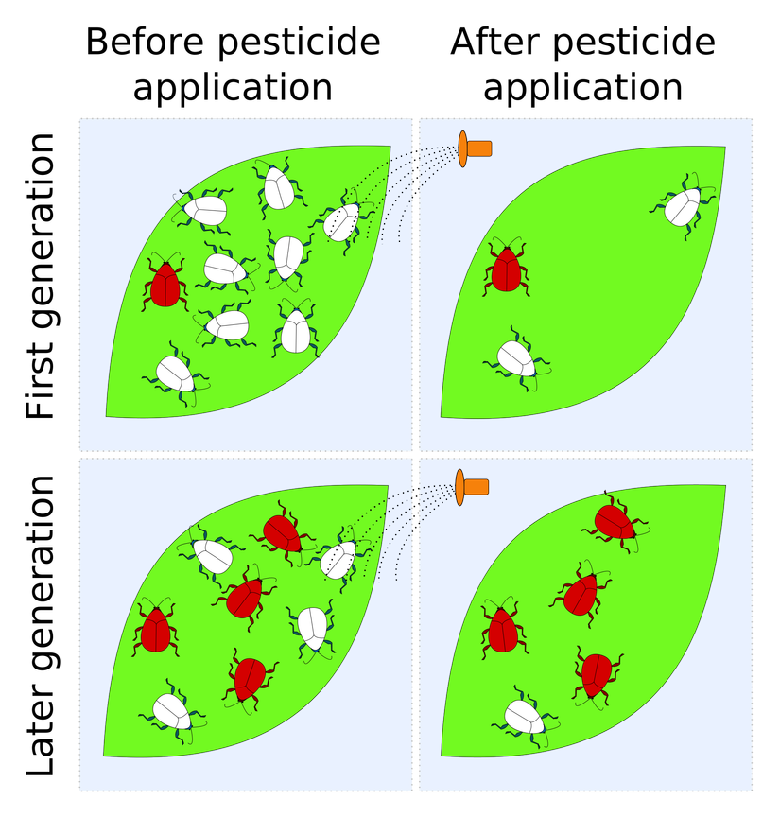
5 - Pesticide paradox
Effectiveness of test cases begins to decrease after a number of runs
Regularly review and update test cases
How can you apply this principle:
Variation of input data
Cover more scenarios
Increase duration of test
Increase recurrences of test
You cannot simply depend on existing test cases and techniques

Slide 24
6 - Testing is context-dependent
The way you test one piece of software will differ from another
Tests are performed differently in different contexts
Different user types – Admin V regular user
Security – Banking, healthcare, education
POS system will require different testing than an ATM
You would never test an e-commerce site the same way as an android application
All applications are not made equal
And neither should their test strategies
Different techniques are used depending on the software

Slide 25
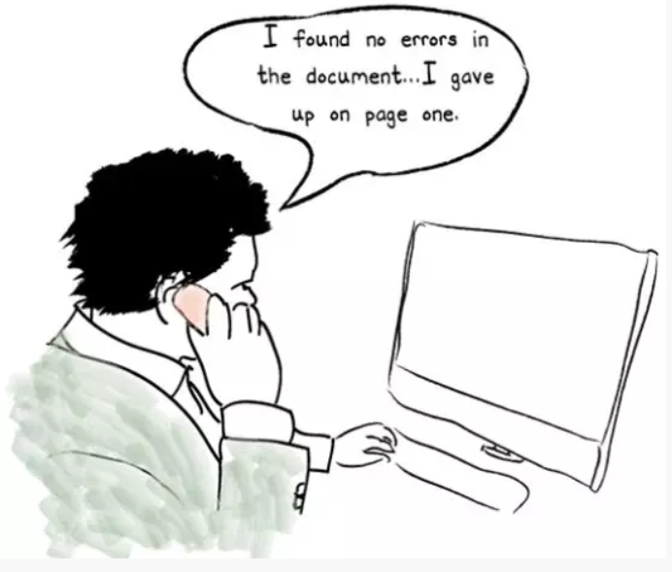
7 - Absence of errors fallacy
Just because no errors have been found, does not mean that you have good software
Must consider the business requirement when testing
Finding and fixing defects does not help if the system is unstable or does not fulfil a users needs
Example:
Even completely testing all the specified requirements and fixing all the defects are not enough if the built system is not user friendly. It means it does not meet the customer’s expectations.

Slide 26
Fundamental test process

Slide 27
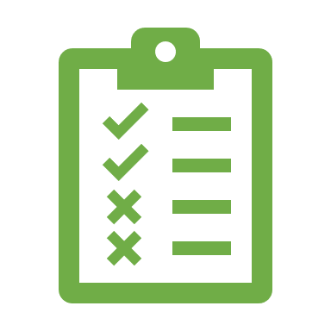
What is a test process
Testing is a process rather than a singular activity
Effectiveness and quality of testing is determined by the quality of the test process used.
This is a key element of what testers do
Like most disciplines, the most visible part is running tests
Test execution (Testing)
Coding (Developers)
Deployment (operations)
There are many steps in the process before getting to these ‘visible’ parts.

Slide 28
Fundamental Test Process
Planning and control
Analysis and design
Implementation and execution.
Evaluating exit criteria and reporting
Test closure activities.
Notes:
Although the main activities are in a broad sequence, they are not undertaken in a rigid way. An earlier activity may need to be revisited. A defect found in test execution can sometimes be resolved by adding functionality that was originally not present (either missing in error, or the new facilities are needed to make the other part correct). The new features themselves have to be tested, so even though implementation and execution are in progress, the ‘earlier’ activity of analysis and design has to be performed for the new features

Slide 29
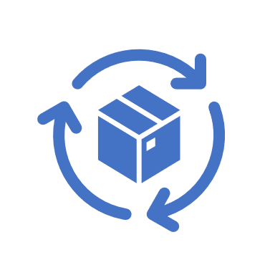
Iteration of Activities
The main activities are not completed in rigid order
Modern software development, including testing, takes an iterative approach (Agile)
While a feature may be under test ‘implementation and execution’
Others may be at analysis stages
All need to be tested in a given development cycle.
so even though execution of tests has started, analysis is also ongoing
These main activities are regularly started in parallel
Time pressure often means that test execution begins before all tests have been designed.

Slide 30

Test Planning And Control
Planning
Determining what will be tested and how.
How activities will be done
Who will complete them
Roles and responsibilities
Completion Criteria (definition of done-ish)
Control
What to do when activities don’t match the plan
Embrace change to meet targets
Monitoring and adjusting iterations

Slide 31

Test Analysis and Design
Concerns the detail of what to test
Test conditions
Test cases
More specific detail about what is required to test
Any prerequisites
Environment requirements
Systems needed
Data required for test cases
Interface specifications
Outlines expected results based on use cases and requirements analysis
Can the planned test actually be executed?
Notes:
Reviewing requirements, architecture, design, interface specifications and other parts, which collectively comprise the test basis.
Analysing test items, the specification, behaviour and structure to identify test conditions and test data required.
Designing the tests, including assigning priority.
Determining whether the requirements and the system are testable.
Detailing what the test environment should look like, and whether there are any infrastructure and tools required.
Highlighting the test data required for the test conditions and test cases.
Creating bidirectional traceability between test basis and test cases.

Slide 32

Test Implementation and Execution
Action of actually running the planned tests
Set up / Tear down activities
Deployment of systems
Sanity checking of test systems
Import/set up of data etc
Defining a run procedure
Efficient test time utilisation
Logical ordering of testing e.g. does one test depend on another?
Not possible without preceding steps
Notes:
Test implementation and execution is where the most visible test activities are undertaken, and usually have the following parts:
Developing and prioritising test cases, creating test data, writing test procedures and, optionally, preparing test harnesses and writing automated test scripts.
Collecting test cases into test suites, where tests can be run one after another for efficiency.
Checking the test environment set-up is correct.
Running test cases in the determined order. This can be manually or using test execution tools.
Keeping a log of testing activities, including the outcome (pass/fail) and the
versions of software, data, tools and testware (scripts etc.).
Comparing actual results with expected results.
Reporting discrepancies as incidents with as much information as possible, including if possible causal analysis (code defect, incorrect test specification, test data error or test execution error).
Where necessary, repeating test activities when changes have been made following incidents raised. This includes re-execution of a test that previously failed in order to confirm a fix (retesting), execution of a corrected test and execution of previously passed tests to check that defects have not been introduced (regression testing).

Slide 33
Test Implementation and Execution
Outcomes need to be recorded and data logged
Log files
Images
Data input/output
Discrepancies require investigation - hen fixed – retest
has the issue been fixed (restarting)?
has anything else broken (regression)?
Notes:
Test implementation and execution is where the most visible test activities are undertaken, and usually have the following parts:
Developing and prioritising test cases, creating test data, writing test procedures and, optionally, preparing test harnesses and writing automated test scripts.
Collecting test cases into test suites, where tests can be run one after another for efficiency.
Checking the test environment set-up is correct.
Running test cases in the determined order. This can be manually or using test execution tools.
Keeping a log of testing activities, including the outcome (pass/fail) and the
versions of software, data, tools and testware (scripts etc.).
Comparing actual results with expected results.
Reporting discrepancies as incidents with as much information as possible, including if possible causal analysis (code defect, incorrect test specification, test data error or test execution error).
Where necessary, repeating test activities when changes have been made following incidents raised. This includes re-execution of a test that previously failed in order to confirm a fix (retesting), execution of a corrected test and execution of previously passed tests to check that defects have not been introduced (regression testing).

Slide 34
Lab02 (deadline next week)
Select a web page and try to preform tests to answer questions in slides 30, 31and 33:
1. Planning
2. Control
3. output

Slide 35
Discussion Question exit criteria and reporting
Scenario:
Tests have been planned and executed.
The Completion Criteria states that 85% of tests should be executed.
When the test manager reviews the testing report, she find that the execution figure is 75%
Question: What actions can the test manager take to resolve this discrepancy?
Run more tests
Change the completion criteria

Slide 36
Test Exit Criteria and Reporting
Evaluate exit criteria defined as part of test planning
Did testing achieve its aims as per the planning stage?
Reports prepared for stakeholders – Test summary
What was planned
What was achieved
Highlight differences
What was not tested
Even if the defined criteria was achieved, more testing may also be required

Slide 37

Test Closure activities
Testing has concluded and ensuing everything is cleaned and no longer in use.
Closure activates can include:
Tear down of systems (closure/archiving of systems)
Documentation updated
Reports distributed
Tickets closed (incidents usually)
Tickets created (bugs/improvements/etc)
Pass all test data to operations teams
Lessons learned/retrospective activities

Slide 38
Test types

Slide 39

Testing Types
Unit Testing
Integration Testing
System Testing
Acceptance Testing
Unit Testing
Integration Testing
System Testing
Acceptance Testing
Others:
Performance Testing
Use Case testing
Sanity Testing
Regression testing
Notes:
https://www.applause.com/blog/functional-testing-types-examples
Unit testing. Before you can test an entire software program, make sure the individual parts work properly on their own. Unit testing validates the function of a unit, ensuring that the inputs (one to a few) result in the lone desired output. This testing type provides the foundation for more complex integrated software. When done right, unit testing drives higher quality application code and speeds up the development process. Developers often execute unit tests through test automation.
Unit testing example: A developer builds a calculator app. A unit test would check whether the user can input two numbers and receive an accurate sum. Separate unit tests would validate other calculator functionality, such as subtraction, multiplication and division.
Integration testing. Integration testing is often done in concert with unit testing. Through integration testing, QA professionals verify that individual modules of code work together properly as a group. Many modern applications run on microservices, self-contained applications that are designed to handle a specific task. These microservices must be able to communicate with each other, or the application won’t work as intended. Through integration testing, testers ensure these components operate and communicate together seamlessly.
Integration testing example: A credit card company includes a page where a customer can request a credit increase, which is a separate code base from login functionality. Testers might perform integration tests to make sure the system remembers the user after they navigate to the credit increase page, and again after a successful request.
System testing. With system testing, QA professionals test the software in its entirety, as a complete product. With this type of functional testing, testers validate the complete and integrated software package to make sure it meets requirements. Where necessary, testers can provide feedback on the functionality and performance of the app or website without prior knowledge of how it was programmed. This helps teams develop test cases to be used moving forward. System testing is also referred to as end-to-end testing.
System testing example: An automobile manufacturer produces an in-car entertainment system that gives users functionality for voice control, GPS, a video player, Bluetooth connectivity, mobile phone pairing, touch-screen support and climate control. Testers would assess all of these features individually, but they must also test them as a complete system to ensure interoperability and a good user experience.
Acceptance testing. The purpose of acceptance testing is purely to ensure that the end user can achieve the goals set in the business requirements. Rather than focus on functionality of specific features, acceptance testing involves reviewing the feature-complete application flow and end-to-end experience. User acceptance testing (UAT) and beta testing, subsets of acceptance testing, involve end users to conduct their analysis of the finished product. From there, the organization can evaluate that feedback and make changes.
Acceptance testing example: A software company releases a product that enables its users to manage big data. Upon release of a new version of the software, a group of that company’s most significant users conducts user acceptance testing to determine whether the new version meets their primary needs and how the product can be improved.

Slide 40
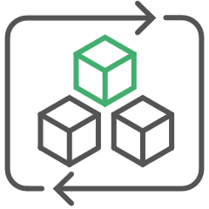
Unit Testing
Also known as component testing
Test each unit of functionality individually
Smallest testable part of an application e.g.
Does a button behave as expected?
Does the UI display appropriately?
Is the price calculated correctly?
A white box technique
Will usually require mock data/variables/functions etc

Slide 41

Unit Testing Benefits
Basic testing of individual functions
Can aid in highlighting changes to code – bugs
Can test in functions without dependency on other parts of the software
Easily automated – increases speed of testing
Based on test cases/requirements

Slide 42
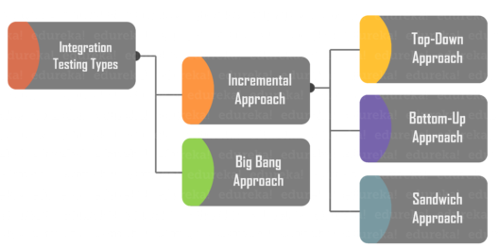
Integration Testing
Involves building a system from its components and testing it for problems that arise from component interactions.
Used to verify that software modules work in unity
Defects may still exist after unit testing:
Changing requirements are not always captured in module development. Integration testing becomes a necessity.
External interfaces could be erroneous
Inadequate exception handling could cause issues
Many strategies for integration testing:

Slide 43
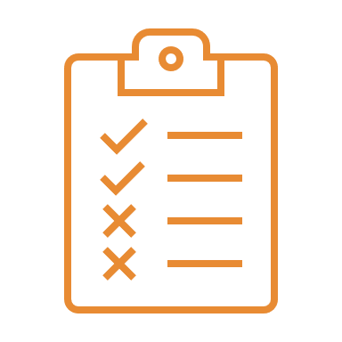
Big Bang Approach
In Big Bang Approach, integration testing takes place after all modules are developed and unit tested.
All modules integrated at once
Why use big bag
Convenient for small systems
But
Interfaces in a system can be easily missed
Less time to execute If waiting for all modules to be completed.
No prioritisation
Notes:
Big Bang Testing
Big Bang Testing is an Integration testing approach in which all the components or modules are integrated together at once and then tested as a unit. This combined set of components is considered as an entity while testing. If all of the components in the unit are not completed, the integration process will not execute.
Advantages:
Convenient for small systems.
Disadvantages:
Fault Localization is difficult.
Given the sheer number of interfaces that need to be tested in this approach, some interfaces link to be tested could be missed easily.
Since the Integration testing can commence only after “all” the modules are designed, the testing team will have less time for execution in the testing phase.
Since all modules are tested at once, high-risk critical modules are not isolated and tested on priority. Peripheral modules which deal with user interfaces are also not isolated and tested on priority.

Slide 44
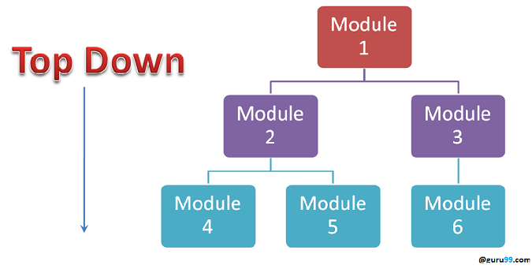
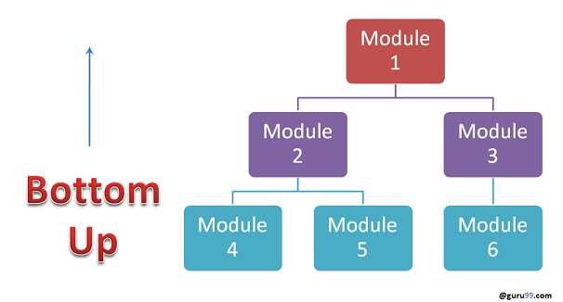
Incremental - Top Down and Bottom Up
Test two or more modules that are logically related. Other modules are integrated incrementally as they are completed.
Top down
Develop the skeleton of the system and populate with modules
Lower level modules tested first
Bottom up
Integrate infrastructure components then add functional components.
Notes:
Stubs and Drivers
Stubs and Drivers are the dummy programs in Integration testing used to facilitate the software testing activity. These programs act as a substitutes for the missing models in the testing. They do not implement the entire programming logic of the software module but they simulate data communication with the calling module while testing.
Stub: Is called by the Module under Test.
Driver: Calls the Module to be tested.
Bottom-up Integration Testing
Bottom-up Integration Testing is a strategy in which the lower level modules are tested first. These tested modules are then further used to facilitate the testing of higher level modules. The process continues until all modules at top level are tested. Once the lower level modules are tested and integrated, then the next level of modules are formed.
Advantages:
Fault localization is easier.
No time is wasted waiting for all modules to be developed unlike Big-bang approach
Disadvantages:
Critical modules (at the top level of software architecture) which control the flow of application are tested last and may be prone to defects.
An early prototype is not possible
Top-down Integration Testing
Top Down Integration Testing is a method in which integration testing takes place from top to bottom following the control flow of software system. The higher level modules are tested first and then lower level modules are tested and integrated in order to check the software functionality. Stubs are used for testing if some modules are not ready.
Advantages:
Fault Localization is easier.
Possibility to obtain an early prototype.
Critical Modules are tested on priority; major design flaws could be found and fixed first.
Disadvantages:
Needs many Stubs.
Modules at a lower level are tested inadequately.

Slide 45
Exercise Lab-03(deadline a week after lab02)
Take your previous example of the webpage or whatever you have selected:
Can you think of any suitable test cases for a POST system?
Try think of a unit test and an integration test
Examples:
Test any used case, such as
Test a lookup for a product specification from the product catalogue
Item should contain a valid name
Or any other example
POST sample test cases:
https://www.guru99.com/testing-for-retail-pos-point-of-sale-system.html
https://www.softwaretestinghelp.com/how-to-test-point-of-sale-pos-system/

Slide 46

System Testing
System testing, also referred to as system-level tests or system-integration testing, is the process in which a quality assurance (QA) team evaluates how the various components of an application interact together in the full, integrated system or application.
Examines every component to ensure they all work together
Usually, a form of Black Box testing
Focuses on functionality
Takes place prior to final acceptance testing
Example:
Every kind of user input provides the correct response

Slide 47

Acceptance Testing (UAT)
Acceptance testing is conducted to determine of the requirements of a specification are met
Performed by
End users
Clients
Why acceptance testing
Developers/Product teams have created features based on their “own” understanding
Requirements changes not always communicated
Client says “that’s not what I meant”
Often classified into ‘Alpha’ or ‘Beta’ releases
Aims to have no surprises when software is released

Slide 48

Other testing Phases
Performance Testing
Test speeds, bandwidth etc
Use Case testing
Test specific use cases
Sanity Testing
Basic testing to validate a system – e.g. a system deployment
Regression testing
Test for code regressions between sprints
Stress testing
Test a system beyond its maximum – similar to performance testing
Release testing
Based on use cases

Slide 49
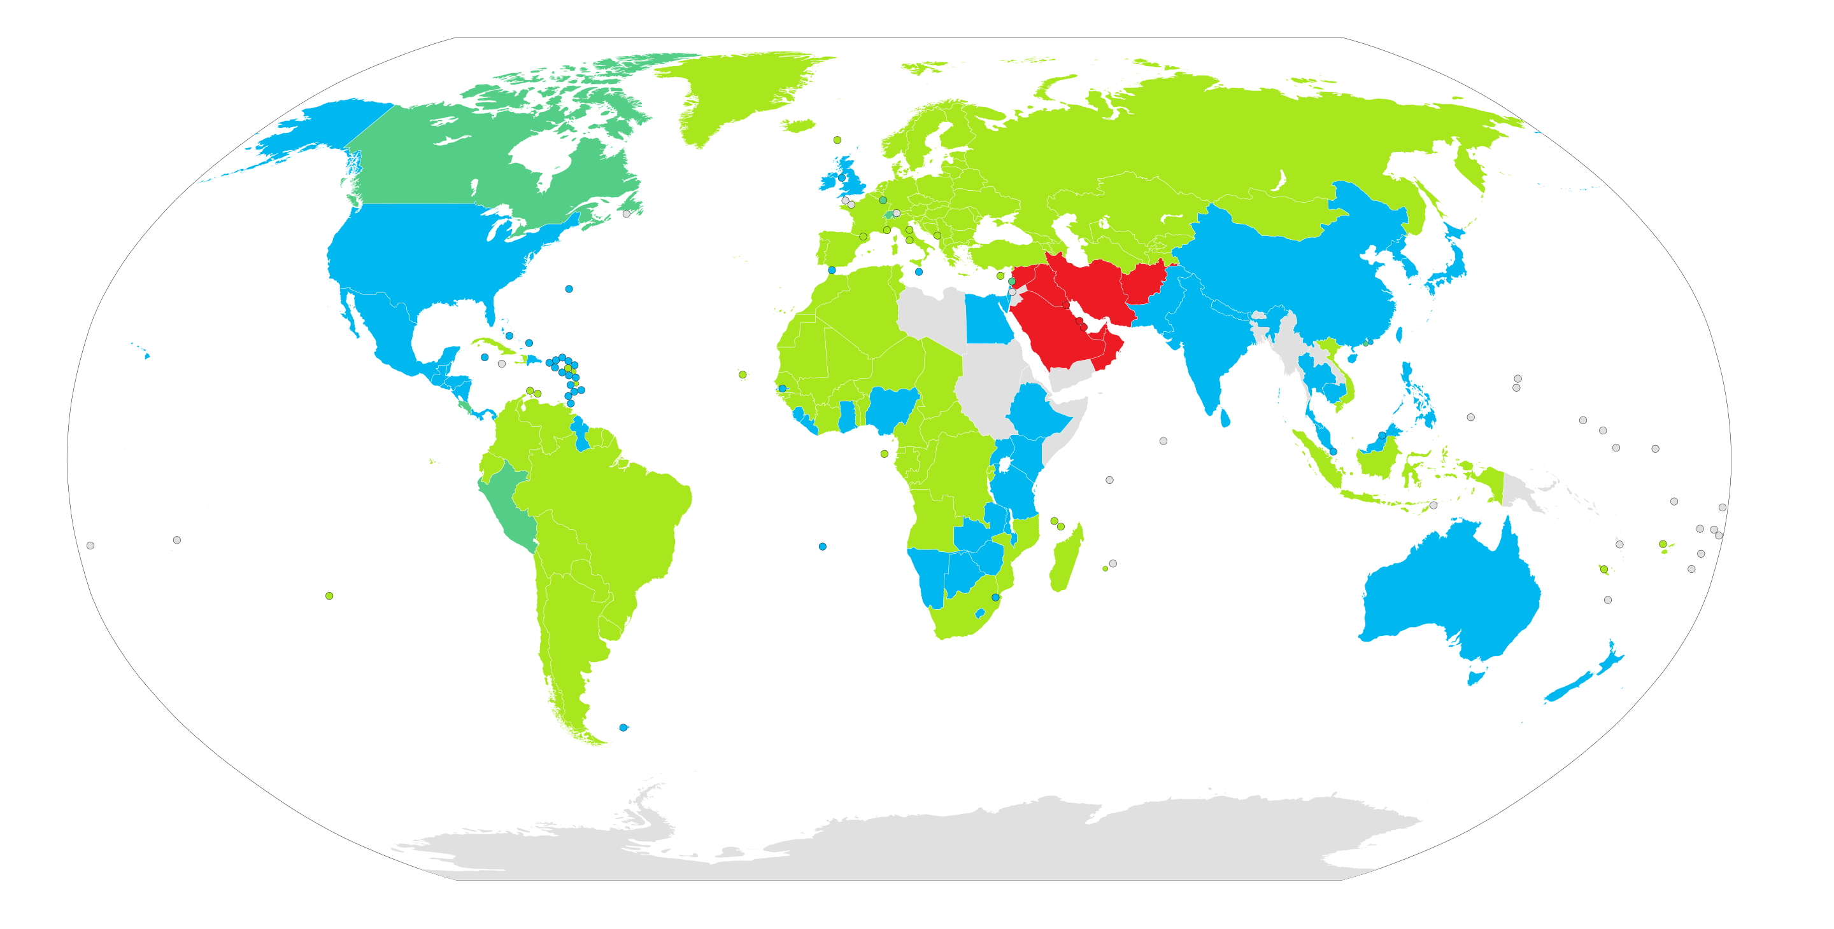
Real Life Example - CSV
Comma Separated values
In Europe, different countries use different delimiters as a decimal point
Ireland/UK – usually a “ . “
Germany – Usually a “ , ”
Dot (.)
Comma (,)
Both (varies by location)
Arabic decimal separator (,)
Data Unavailable

Slide 50

Real Life Example - CSV
In finance software that was developed, a client could upload an invoice in CSV file format.
Product Teams/Developers used a Dot (.) as a separator.
Product and Dev teams were in the Ireland and the UK
Tests were carried out in Ireland and the UK – no issues with file uploads found.
Dev team testing, QA testing, operations testing, sanity testing etc
Client behaviour:
Before uploading, clients would edit the CSV file in MS Excel
BUT – when saving the file MS Excel would automatically update it to account for separator differences in different countries
Result: An invalid file that used a comma as a decimal delimiter, which could not be handled by the system.
Result: clients across Europe could not use the software at all.

Slide 51
Real Life Example – Solution and impact
Solution (temporary)
Very inconvenient work arounds were available
Solution (permanent)
Redesign
Analysis of worldwide delimiters
Redevelopment of a module and retesting
Impact
Significant reputational damage
Unhappy customers
Extra redevelopment and testing effort
Knock on impact on the next sprints
Late deliveries of software
Etc etc

Slide 52
Testing industry

Slide 53
Software Testing Market
Exceeded 40 Billion USD in 2020
Growth at 7%
Adoption of AI and ML
Adoption of DevOps methodologies
Growing digitalisation of developing economies
Investment in AI
Functional and non-functional testing
Banking and Financial services sector (28.5% )
Notes:
Non functional Testing:
Performance Tests.
Load Tests.
Stress Tests.
Volume Tests.
Security Tests.
Upgrade & Installation Tests.
Recovery Tests

Slide 54
Testing Industry Trends
Focus on automation
Shift Left
Differing views between ‘on the ground’ and ‘views from above’
Challenges in talent acquisition
DevOps - CI/CD Process – Continuous Testing
https://www.linkedin.com/pulse/state-software-testing-industry-2021-anish-roy/

